Slide 1
2022 Wastewater service provider training

Slide 2
agendA
Application Process
Energy Assessment Template
Critical Information
Additional Wastewater Offering
Registered Trade Ally Benefits
Getting Started
Resources

Slide 3
APPLICATION PROCESS
Receive pre-approval before beginning the assessment
Incentive is 90% of the assessment cost (up to $5,000):
Paid directly to the WSP
Incentive credit must be indicated on invoice for pre-approval
Contact information for questions:
Melissa Rickert, Quality Assurance and Program Specialist: melissa.rickert@focusonenergy.com
Submit the proposal and application to Business@focusonenergy.com

Slide 4
ENERGY ASSESSMENT TEMPLATE
Requirements:
Executive summary (one page maximum)
Introduction and background information (including BOD loads)
Existing infrastructure and processes
Energy use analysis
Audit findings (potential projects):
Low cost/no cost recommendations
Capital improvement recommendations
Supporting calculations for energy savings
Appendix 1: CMAR data
Visit our website to download the SAMPLE Wastewater Plant Assessment
Notes:
Template included minimum requirements. It is ok to provide additional information as part of the assessment such as renewable energy opportunities, phosphorus removal, energy resiliency, etc…
For Capital Improvement recommendations – we are looking to meet our standard custom criteria (1.5 to 10 year simple payback)
We are looking for energy saving projects that make practical sense – not necessarily a complete facility upgrade. Implement a smaller blower or an Adjustable Speed Drive for modulating system down – instead of replacing 3 system blowers with new ones.

Slide 5
CRITICAL INFORMATION
Must receive pre-approval before beginning assessment:
Include the Incentive Agreement signed by both the customer and Energy Advisor
Submit the pre-approval application to melissa.rickert@focusonenergy.com
Focus on Energy reserves the right to request revisions of the reports until they meet the minimum requirements
Incentive payment will be delayed until report meets all minimum requirements:
Upon submittal, payment is issued within 8-10 weeks

Slide 6
ADDITIONAL WASTEWATER OFFERING
Project assessment:
Completed following an energy assessment to develop opportunities identified in the report
Assist the customer in the decision-making process of a potentially significant energy savings project
Additional studies may be needed to quantify the savings on a potential upgrade or system process
Studies and develops a complex energy savings project
50% of assessment cost up to $7,500
Capped at 20% of initial annual energy savings projections
Wastewater Plant
Energy Assessment
Project Assessment

Slide 7
REGISTERED TRADE ALLY BENEFITS
Grow your business while helping your customers save
Receive direct payment of incentives
Be listed on the Find a Trade Ally Tool
Participate in special promotions and offerings
Utilize co-branding opportunities to promote your business and Focus on Energy
Notes:
Incentive can be paid directly to Trade Ally with correct invoice showing payment reduction
“Find It With Focus” – Website search will show eligible “service provider” in the area that is chosen
“Endorsement” for being a supporter of the Focus on Energy Program and willingness to participate in the program
Joint Marketing / Cooperative funds and marketing materials

Slide 8
GETTING STARTED
Complete the online WSP Enrollment Application
Become a Registered Trade Ally (if not already)
Send application and proposal to Joe Cantwell to start the pre-approval process

Slide 9
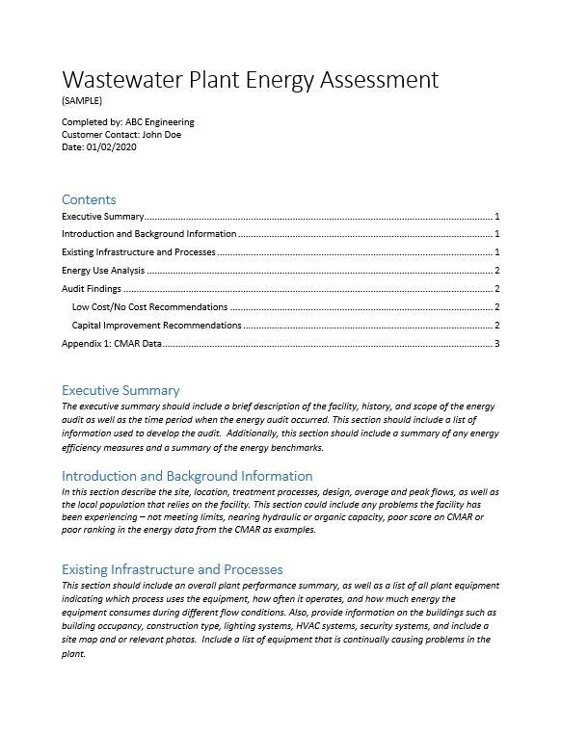
RESOURCES
WWPEA Sample Assessment

Slide 10
ENERGY BEST PRACTICES GUIDE
Outlines the basic steps in building an energy management program for water and wastewater facilities
Provides general best practices and recommendations
Download a free copy

Slide 11
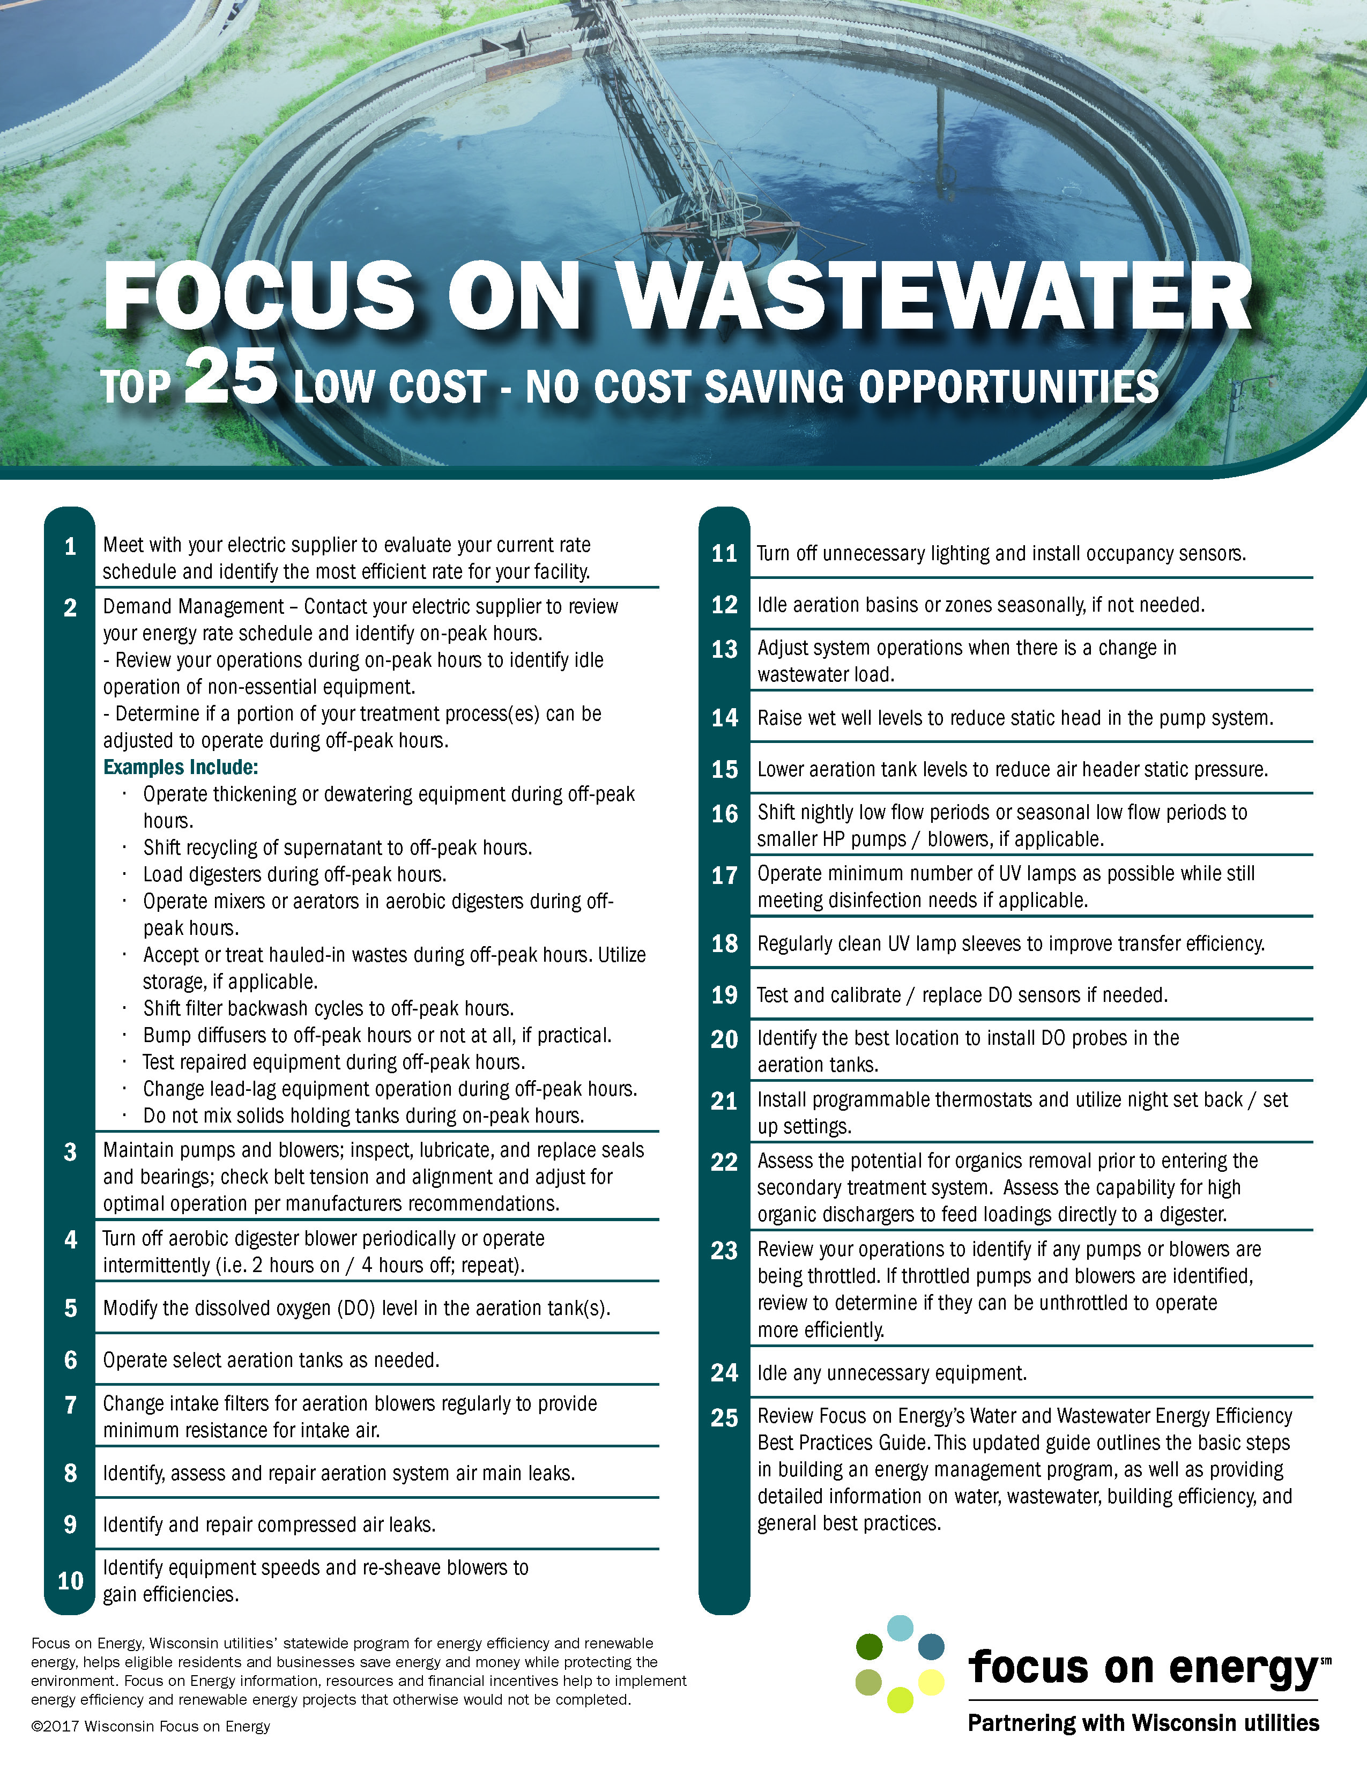
TOP 25 ENERGY SAVING OPPORTUNITIES
Low cost – no cost checklist

Slide 12
888.623.2146
focusonenergy.com/wwfacilities
Notes:
Call: 800.762.7077
Email: focusinfo@focusonenergy.com
Visit: focusonenergy.com
Mail: Focus on Energy 1 South Pinckney, Suite 340 Madison, WI 53703

Slide 13
THANK YOU

